Slide 1


MP-A-19
BHOJ REDDY ENGINEERING COLLEGE FOR WOMEN DEPARTMENT OF INFORMATION TECHNOLOGY III B Tech. II Sem. A Section Mini Project Abstract Seminar Academic Year 2024-25 Date: 26 - 04 -2025 Smart Object And Text Detection With Multilingual Translation
PRESENTED
BY
Pinjara Akshita 22321A1209
Kummari Nandini 22321A1255
Pasupunoor Nishita 22321A1259
Saleha Farha Tasneem Rahath Dr C Murugamani
Project Guide Co Ordinator HOD-IT

Slide 2
CONTENTS
Introduction
Existing System
Proposed System
Functional Requirements
Non-functional Requirements
Modules
Computational Resources
Technical Architecture
System Architecture
UML Diagrams

Slide 3
INTRODUCTION
In today's increasingly globalized world, the ability to process and understand various types of information across different languages and formats is crucial. Smart object and text detection technologies are at the forefront of this evolution, enabling systems to recognize, interpret, and extract meaningful data from images and videos.
The combination of object and text detection with multilingual translation opens up new possibilities in fields such as e-commerce, education, travel, and accessibility services. By enabling computers to "see" and "understand" the world in different languages, this technology has the potential to break down cultural and linguistic divides, paving the way for a more connected and inclusive world.

Slide 4
EXISTING SYSTEM
The existing systems for object detection and text detection in images often rely on traditional computer vision techniques and OCR algorithms.
These systems may lack accuracy and efficiency, leading to limitations in accurately recognizing and translating objects and text in images, especially in complex scenarios or multilingual contexts.
Additionally, these systems may not provide seamless integration of object detection, text detection, and translation functionalities, making the user experience fragmented and less efficient.

Slide 5
DISADVANTAGES:
High Computational Requirements
Potential Biases In Object and Text Recognition
Limited Accuracy For Complex Languages
Context-Dependent Translations Issues
Data Privacy and Security Concerns
High Development and Maintenance Costs

Slide 6
PROPOSED SYSTEM
It integrates these functionalities into a unified system architecture that seamlessly handles the recognition and translation of objects and text in images.
This proposed system also incorporates multilingual translation capabilities to provide accurate and reliable translations in multiple languages.
The proposed system aims to overcome the limitations of the existing systems by utilizing the advanced capabilities of the Google Cloud Vision API for Object Detection and Text Detection.

Slide 7
ADVANTAGES
Fast and accurate detection
Automated translation
Removes language barriers
Increases global reach
Improves customer service
Cost savings
Enhanced user experience
Improved security and surveillance

Slide 8
FUNCTIONAL REQUIREMENTS
These are the requirements that the end user specifically demands as basic facilities that the system should offer. They are basically the requirements stated by the user which one can see directly in the final product, unlike the non-functional requirements.
Upload Image: The system should allow the user to upload an image to be translated.
Object Detection: The system should detect objects within the uploaded image using Google Cloud Vision API.
Landmark Detection: Landmark detection is a fundamental task in computer vision and has a wide range of applications that contribute to advancements in various fields.
Translation: The system should translate the text within the uploaded image to the user's preferred language using a translation API.

Slide 9
NON-FUNCTIONAL REQUIREMENTS
These are basically the quality constraints that the system must satisfy according to the project contract. The priority or extent to which these factors are implemented varies from one project to other. They are also called non-behavioral requirements.
Accuracy
Speed
Scalability
User Interface
Security
Multilingual Support

Slide 10
MODULES
1.User Interface Module
This module would handle the interaction between the user and the application.
2.Image Processing Module
This module would handle the processing of the uploaded images, including object detection, text detection.
3.Translation Module
This module would handle the translation of the extracted text into the preferred language.
By structuring the application in a modular way, each component can be developed and tested independently, making it easier to maintain and update the application over time.
Additionally, the use of containerization technology can simplify deployment and scaling, making it easier to accommodate growing user base.

Slide 11
TECHNOLOGY STACK AND DEVELOPMENT PHASE
Technology Stack
Node.js: Server-side JavaScript runtime for efficient asynchronous programming.
Express.js: Minimalist web framework for building Node.js applications and APIs.
HTML/CSS,Javascript: Markup and Styling languages for structuring and designing applications.
Development Phase
Requirements and Design
Frontend Development
API Integration
Testing and Refining

Slide 12
COMPUTATIONAL RESOURCES
Hardware Requirements:
Processor : Intel i5 or i7, clock speed of atleast 2.4 GHz
RAM : 4GB is recommended
Storage : 250 GB SSD is recommended
Graphic Card : Minimum of 2 GB VRAM
Operating System : Windows 10, or macOS, or Android
Software Requirements:
Google Cloud Vision API
Google Translate API
Landmark Detection
Programming languages

Slide 13
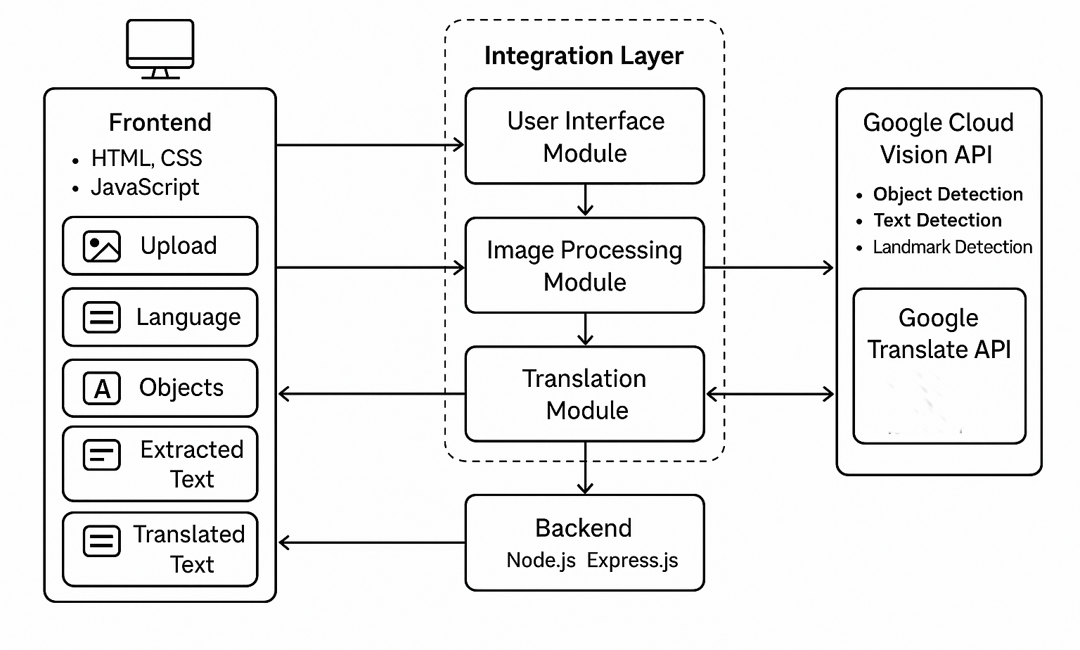
TECHNICAL ARCHITECTURE

Slide 14
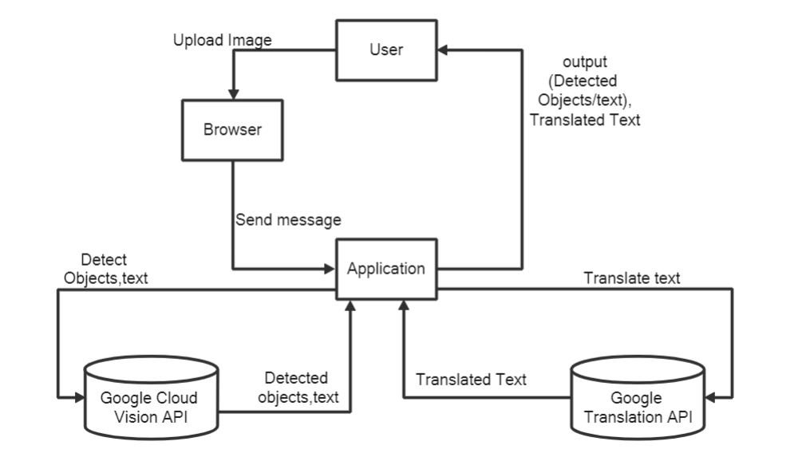
SYSTEM ARCHITECTURE

Slide 15
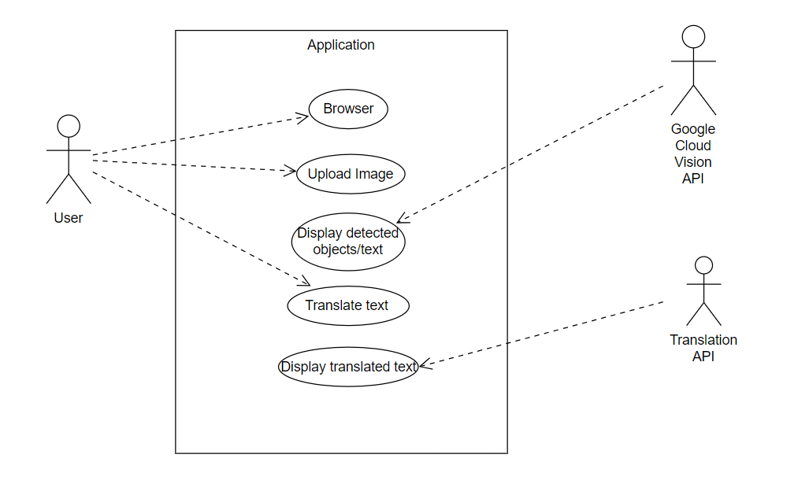
UML DIAGRAMS
Use case diagram:

Slide 16
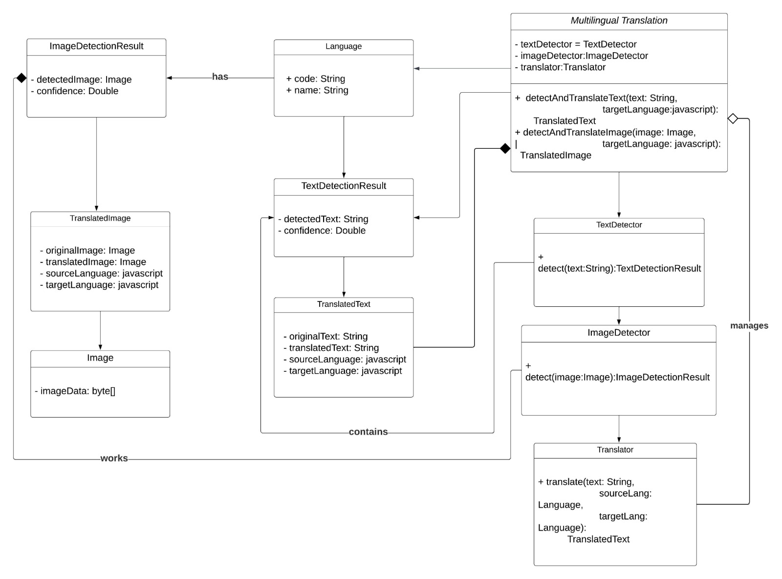
Class diagram:

Slide 17
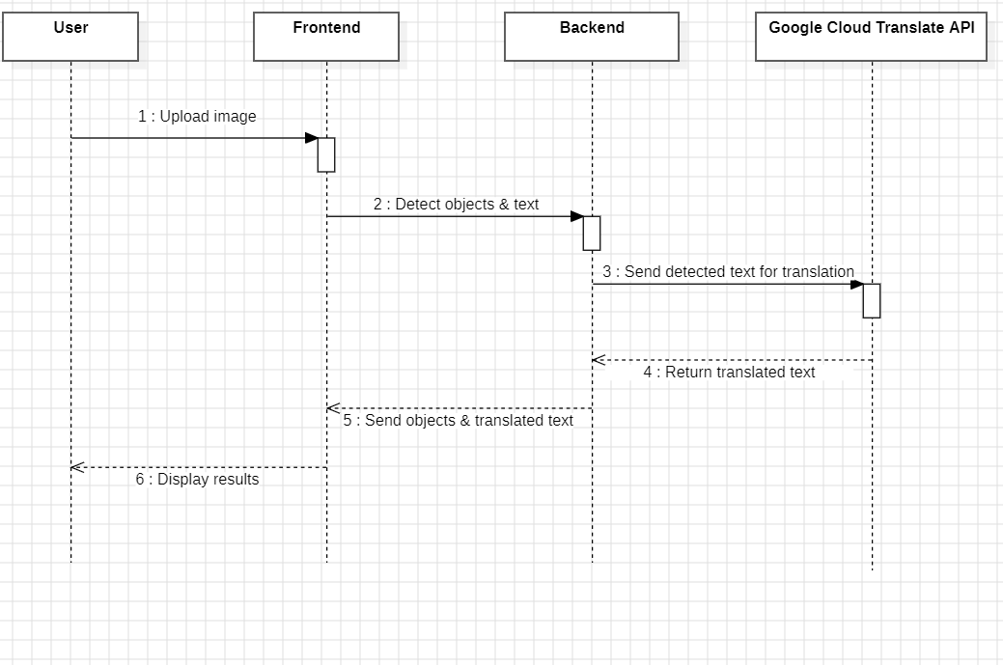
Sequence diagram:

Slide 18
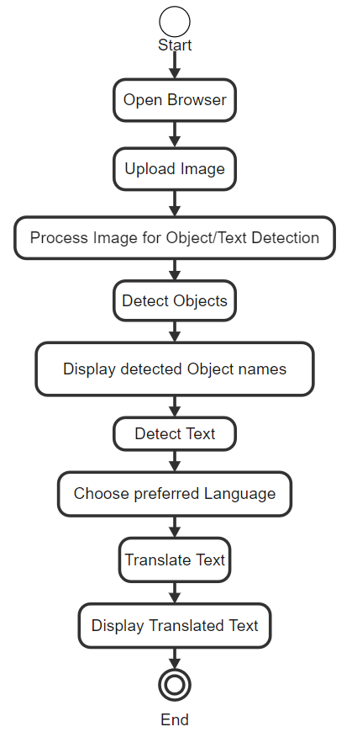
Activity diagram:

Slide 19
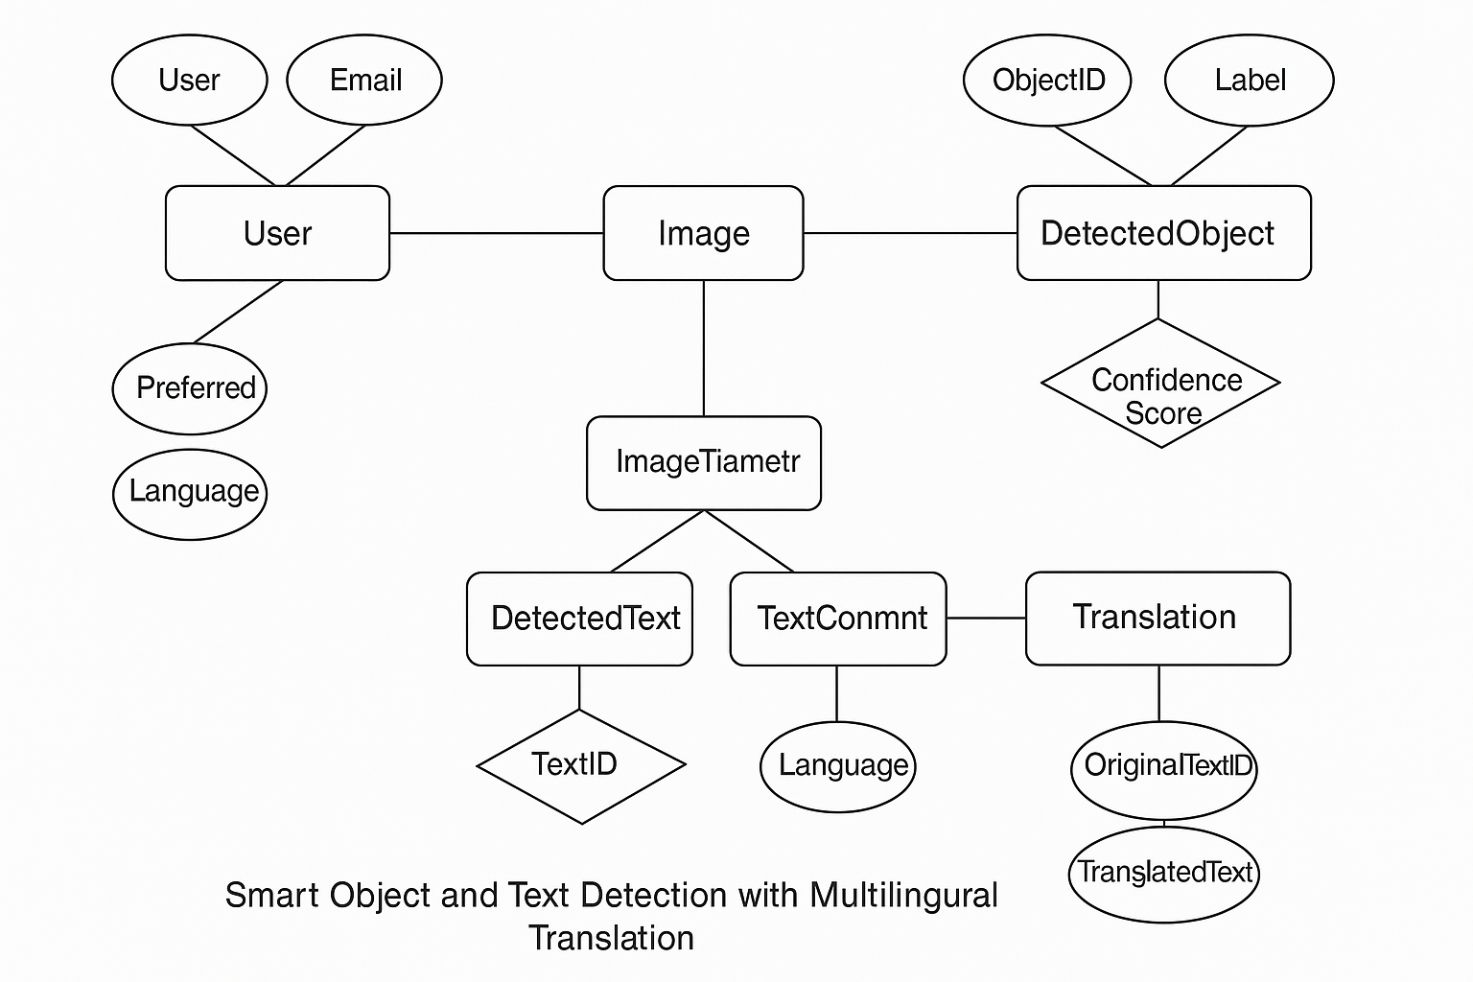
ER diagram:

Slide 20


